Slide 1
Toronto Housing Prices and Crime Rate
Alicia Freites
Eric Hakuzimana
Valerie Thomas
Winnie Wu
March 13, 2019
Notes:
ERIC

Slide 2
Table of Contents
Introduction
Questions & Data
Data Cleanup & Exploration
Data Analysis
Conclusion
Post Mortem
Discussion
Notes:
ERIC

Slide 3
Introduction
Primary Research Question
Hypothesis
What is the relationship between crime and housing prices in Toronto?
Neighbourhoods with higher crime rates will have lower housing prices.
Supporting Questions
Relationship
Is there an inverse relationship?
Can we find trends over time?
Are they correlated, what is the R² value?
Crime
Should/can we look at all crime or a specific type of crime?
Housing prices
What types of homes?
Rentals and/or ownership?
Will we be able to get a representative sample?
Notes:
ERIC
Define the core message or hypothesis of your project.
Describe the questions you asked, and why you asked them
NEXT slide: Describe whether you were able to answer these questions to your satisfaction, and briefly summarize your findings

Slide 4
Data
Challenges/Limitations
Data Sources
Housing price data – lack of y/o/y data, unable to access past MLS sale prices (current listings only)
Crime data – chose to start with 1 type, homicides, as this is most severe
Needed to identify a common data point between crime & housing price
Toronto Police Service Public Safety Data Portal
Kaggle, House Sales in Ontario 2016
Geocoding API
Notes:
ERIC
While we were not able to source data to answer all of the questions, we were able to gather enough inputs explore the relationship between crime (homicides) and housing prices in Toronto for 2016.
Describe whether you were able to answer the questions to your satisfaction, and briefly summarize your findings
Elaborate on the questions you asked, describing what kinds of data you needed to answer them, and where you found it

Slide 5
Data Strategy: Exploration & Cleaning
Data Exploration
Searching for datasets was the main limitation
Explore datasets
After reviewing data, define “high/med/low” levels of housing prices and homicides
Identify top neighbourhoods for homicides & housing prices
Use of neighbourhoods vs. postal codes as this grouping is more understood, and had better fit for homicides
Explore relationships
Sample combined dataset:
Postal Code | Neighbourhood | Total Homicides | Average Housing Price
Notes:
ALICA
we research google to find available datasets, with geocode data available and easy to retrieve for the public. so we could potentially use to solve our research question, “What is the relationship between crime and housing prices in Toronto?” we opened different datasets for real estate, we found one in Kaggle with geocodes, them we found a dataset from the toronto police department that contains geocode as well.
We review and check what type of data points were in the datasets, such as: price for the properties to segment the dataset in price categories, amount of records that we could collect, the geocode, our first explorations the data seems completed and a good prospects for analysis.
them we identify missing variables, right away we identified that we need a common variable to be able to categorize and summarize data, we choose the neighborhoods, but in the datasets, properties addresses did not contain postal codes, and the area name column in properties, was not the same naming as in the toronto police department for neighborhoods, that didn't have postal code.

Slide 6
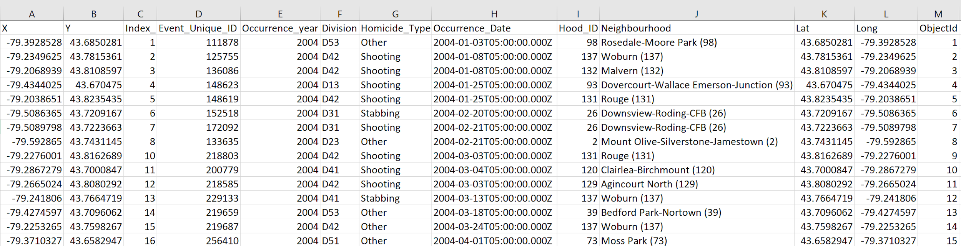
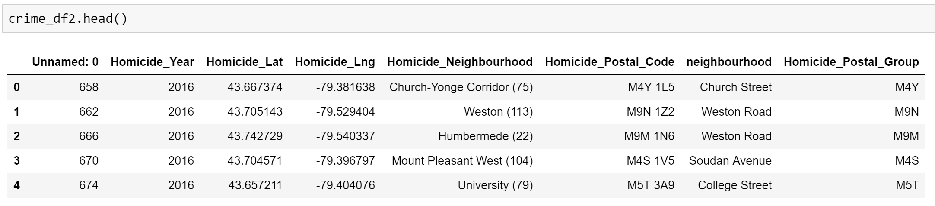
Data Cleanup
Homicide Data
Drop irrelevant columns
Renaming columns
Ensuring no missing data/values etc.
Selecting 2016 dates to match property data
Running Lat & Long through Google API to retrieve postal code and neighbourhood
Count number of homicides in each neighbourhood
Identify neighbourhoods with most homicides
Notes:
ALICIA
we started the data cleaning and adding a to the datasets.
first we change column names, filter only 2016, and them make the APIS calls to add the postal code and neg.
using jupyter notebooks. the toronto police department covers 7 negbh. we got 75 records instead of a couple of hundreds

Slide 7
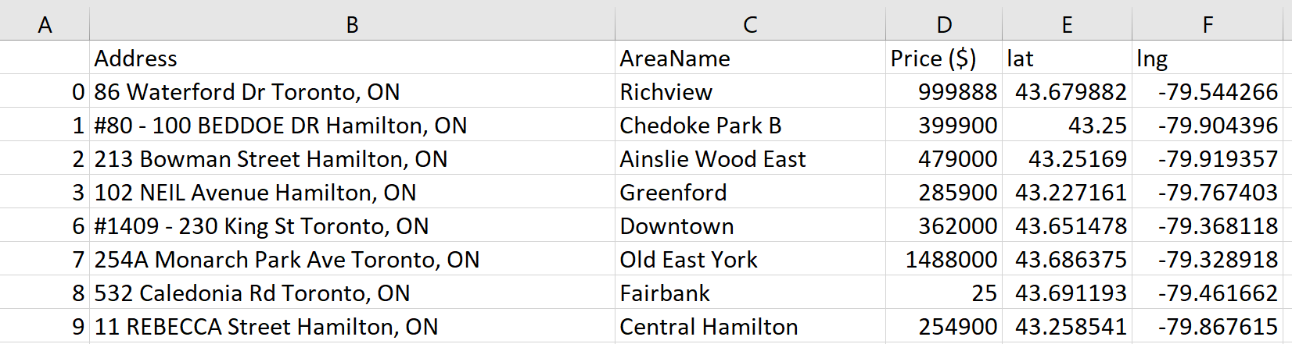
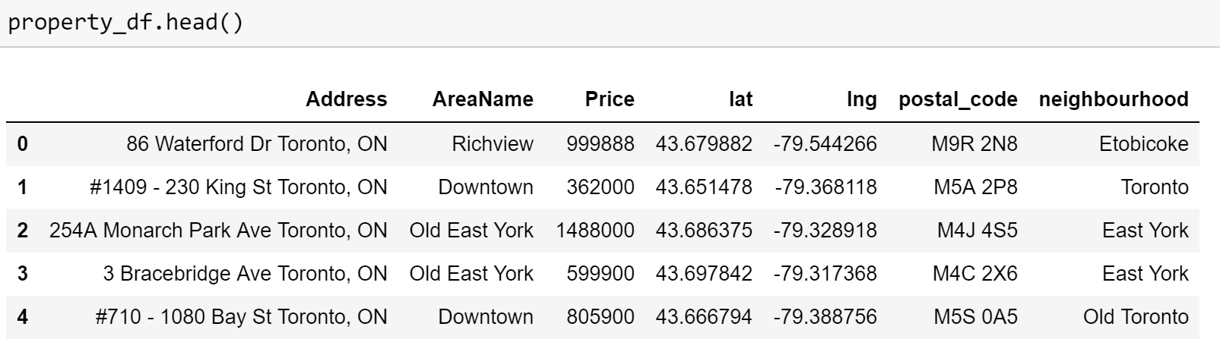
Data Cleanup
Housing Price Data
Filtering for Toronto Area addresses
Drop n/a
Drop housing prices below $50,000 (outliers)
Running Lat & Long through Google API to retrieve postal code and neighbourhood
Calculate average housing price for each neighbourhood
Notes:
ALICIA
properties datasets needed a little bit of more work. we did was change column names, it has special characters and unnamed column that was drop. Them filter missing data for some addresses and also any price that was less than 50,000.
them we selected properties, during our exploration we found that the dataset was Ontario, but we have only toronto homicide, so we filtered to select only Toronto. at the end we got 5000 records from 25,000 originally. with that we made the APIs calls, that kept dropping because the max per day is 1,400, needed to wait to collect the 5,000 that we decided to saves in a csv file.
after we still have some differences between the homicide and properties, API calls brought other nebg, some cases we have property data in areas without any homicides or vice versa.

Slide 8
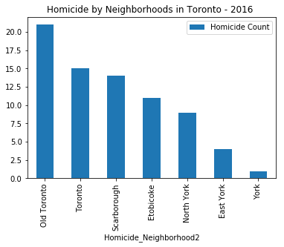
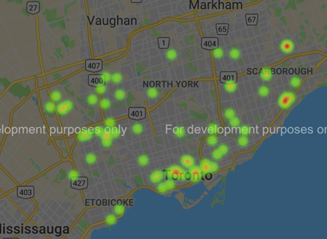
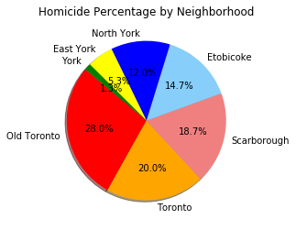
Data Analysis
Q1. Where are homicides occurring? How many homicides per neighbourhood?
For 2016, we found neighbourhoods in Toronto’s downtown core had higher homicide counts, and a few neighbourhoods in Scarborough also had higher homicide counts.
Homicides
Notes:
WINNIE
Discuss the steps you took to analyze the data and answer each question you asked in your proposal
Present and discuss interesting figures developed during analysis, ideally with the help of Jupyter Notebook

Slide 9
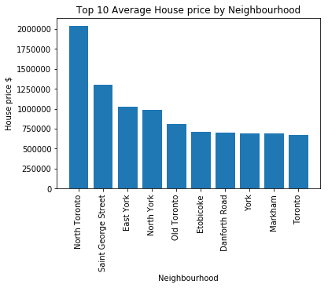
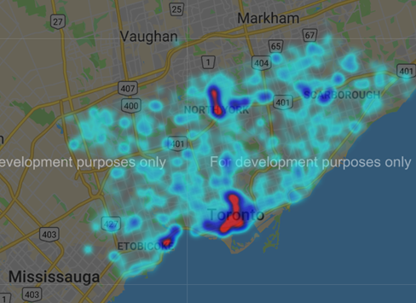
Data Analysis
Q2. Toronto housing prices – what are average prices and where are high/low price neighbourhoods?
We found average housing prices ranged from moderate $600,000 to up to 2 million in other areas. Highest housing prices grouped around North Toronto and in the downtown area.
Housing Prices
Notes:
WINNIE
Discuss the steps you took to analyze the data and answer each question you asked in your proposal
Present and discuss interesting figures developed during analysis, ideally with the help of Jupyter Notebook

Slide 10
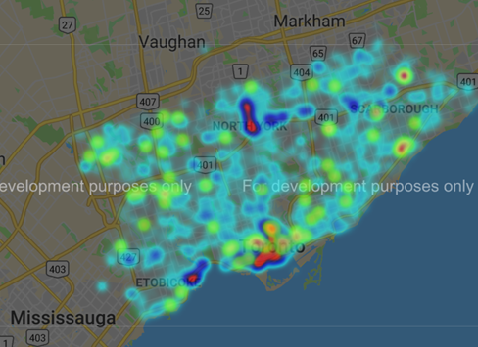
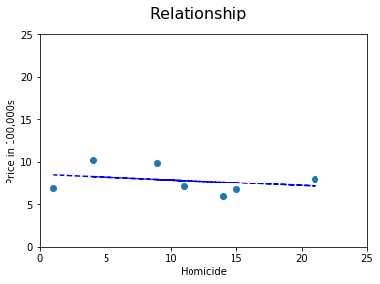
Data Analysis
Q3. How do homicides and housing prices relate to each other?
We found in downtown there are more homicides and higher housing prices. However, outside of the downtown core, higher housing prices are not in the same neighbourhoods with high homicides, and are in areas with lower housing prices. When we run a regression, we can see there is not a relationship between these two data sets.
Housing Prices overlayed with Homicides
r² = 0.08
Notes:
WINNIE
Discuss the steps you took to analyze the data and answer each question you asked in your proposal
Present and discuss interesting figures developed during analysis, ideally with the help of Jupyter Notebook

Slide 11
Conclusion
Based on our analysis, we were not able to derive a clear relationship between homicides and housing prices in Toronto (r² = 0.08), and thus were not able to prove our hypothesis as true.
We acknowledge there are limitations to this analysis which impact these results. For example, by choosing to use homicides as our crime type, we limited the number of data points to compare housing prices to. Additionally, homicides may not be as strong of a factor in choosing a neighbourhood to live in or the value of a home in that neighbourhood as much as other crime times, e.g. break & enter. We also chose to group our findings by ‘neighbourhood’ vs. FSA. The neighbourhoods returned by Google API are larger land areas than FSAs, and when data was combined into one table, there were only 7 for all of Toronto that had homicides. This meant that while we were able to aggregate more homicides in each neighbourhood, the average housing price was diluted. Each of these factors may have impacted the final regression results.
Notes:
VAL
Discuss your findings. Did you find what you expected to find? If not, why not? What inferences or general conclusions can you draw from your analysis?

Slide 12
Post Mortem
Key Challenges
Further Exploration
Housing Price data – could only find one set for Toronto, limiting us to 2016 data only
Postal code/neighbourhood as common key – maxed out limits on API calls
Combining datasets – determining how to merge homicide df and housing price df
Homicide data points are disproportionately smaller than housing price data points
Organizing pushes to GitHub and combining analysis components from different team members
Crime types – Researching how crime types impact home purchases as a starting point, and including those crimes into our analysis
Stats Canada – to layer on additional demographic data such as income or population size of neighbourhoods, to further investigate factors at play
Notes:
VAL
Discuss any difficulties that arose, and how you dealt with them
Discuss any additional questions that came up, but which you didn't have time to answer: What would you research next, if you had two more weeks?
Number of datapoints in each dataset were not well matched (low number of homicides vs. many housing prices) - had to decide on using neighbourhoods (larger areas) vs. FSA (smaller areas called forward sortation area - first 3 postal code characters)

Slide 13
Discussion

